Slide 1


3RD CAPSTONE
PROJECT
BY GHANSHYAM SINGH SHAKTAWAT

Slide 2

CONTENT
01
INTRODUCTION
02
PROBLEM STATEMENT
03
STRATEGY IMPLEMENTED
04
HYPOTHESIS TESTING
05
MODEL IMPLEMENTATION
06
SUMMARY

Slide 3

PROBLEM STATEMENT
The dataset is from an ongoing cardiovascular study on residents of the town of Framingham, Massachusetts. The classification goal is to predict whether the patient has a 10-year risk of future coronary heart disease (CHD). The dataset provides the patients' information. It includes over 4,000 records and 15 attributes. Each attribute is a potential risk factor. There are both demographic, behavioral, and medical risk factors.

Slide 4
STRATEGY
Hypothesis Testing
Hypothesis testing examined heart rate (null: 72), glucose (null: 75), and systolic blood pressure (null: 135).
Tests assessed significant differences from null values, revealing insights into heart rate, glucose, and systolic blood pressure associations or variations.
Findings contribute to understanding how these attributes may differ from expected values, aiding in medical or research contexts.
Model Implementation
Model 1 utilizes logistic classification on the dataset.
Model 2 involves cross-validation and hyperparameter tuning through a grid-search CV model to enhance performance.
Model 3 employs XGBoost classification, and the results are visualized using a beeswarm plot, offering insights into the distribution and performance of the XGBoost model on the dataset.

Slide 5
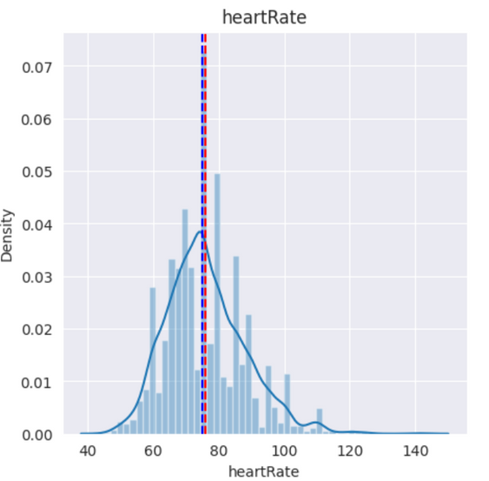
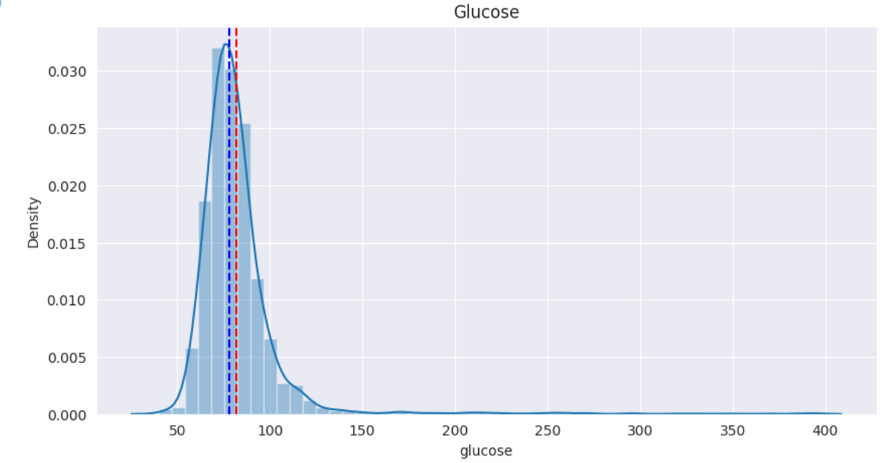

HYPOTHESIS TESTING
Heart-Rate
Glucose
SYS BP
Z-Test
1.Null Value - 72
2. Alternate Hypothesis- N>72
Null Value Accepted.
Z-Test
Null Value - 75
Alternate Hypothesis - N<75
Null value Accepted.
Z-Test
Null Value - 135
Alternate Hypothesis - N<135
Null value Accepted.

Slide 6
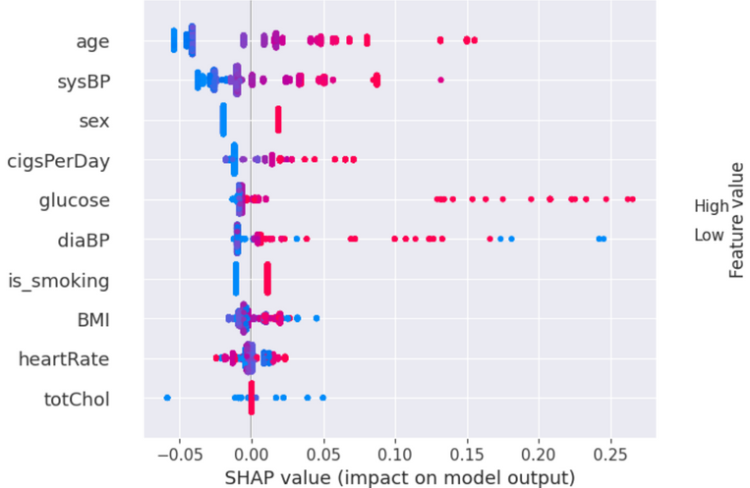

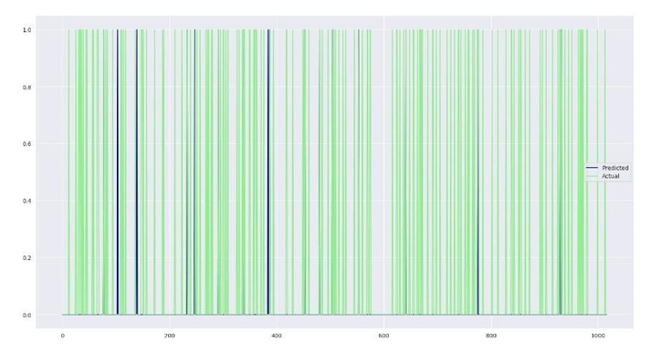
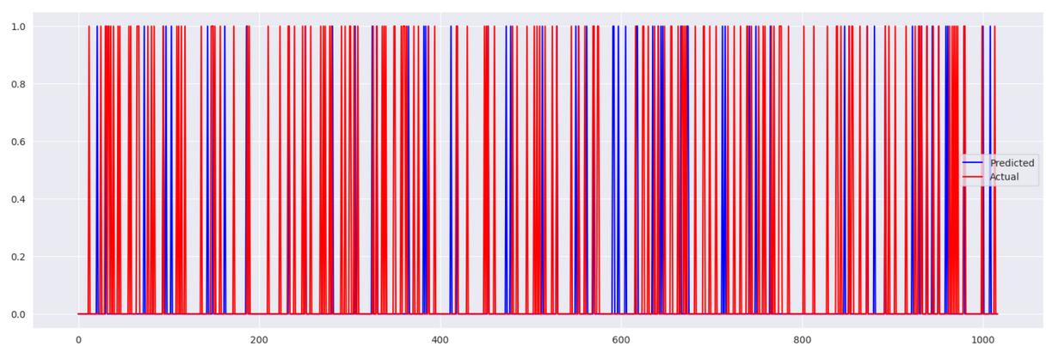
MODEL IMPLEMENTATION
MODEL 3
MODEL 1
MODEL 2
Confusion Matrix = ([2005, 12], [ 332, 24])
Accuracy = 85.50358196375896
roc_auc_score 0.530733150245386
Confusion matrix+ ([2017, 0], [9 , 347])
roc_auc_score 0.9873595505617978
R_2 Score = -1.5139043381535031

Slide 7
SUMMARY
The logistic, grid-search CV, and XGBoost models were applied to the dataset to test hypotheses. Results indicate varying performance across models. Logistic classification provided insights into the data, grid-search CV optimized model parameters, and XGBoost classification offered enhanced predictive capabilities. Combining these approaches contributes to a comprehensive understanding of the dataset, enabling informed decision-making in relevant contexts.
Thank
you!

